Slide 1

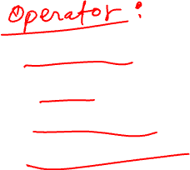

Slide 2


1. Comparison Operators:
Comparison operators allow you to compare values and select documents that satisfy specific conditions.
Examples:
$eq: Matches values that are equal to a specified value.
$ne: Matches values that are not equal to a specified value.
$gt: Matches values that are greater than a specified value.
$lt: Matches values that are less than a specified value.
$gte: Matches values that are greater than or equal to a specified value.
$lte: Matches values that are less than or equal to a specified value.
$in: Matches any of the values specified in an array.
$nin: Matches none of the values specified in an array.
Question 1: Find documents with ages greater than 30.
db.users.find({ age: { $gt: 30 } });
Question 2: Find documents where the price is between $10 and $20.
db.products.find({ price: { $gte: 10, $lte: 20 } });

Slide 3

2. Logical Operators:
Logical operators allow you to perform logical operations on multiple conditions.
Examples:
$and: Joins query clauses with a logical AND and selects documents that satisfy all the conditions.
$or: Joins query clauses with a logical OR and selects documents that satisfy at least one of the conditions.
$not: Inverts the effect of a query expression and selects documents that do not match the specified condition.
$nor: Joins query clauses with a logical NOR and selects documents that fail all the conditions.
Question 1: Find documents where the age is greater than 25 and the gender is "female".
db.users.find({ $and: [ { age: { $gt: 25 } }, { gender: "female" } ] });
Question 2: Find documents where either the quantity is greater than 1000 or the price is less than $10.
db.products.find({ $or: [ { quantity: { $gt: 1000 } }, { price: { $lt: 10 } } ] });

Slide 4

3. Evaluation Operators:
Evaluation operators allow you to perform advanced operations, such as regex matching and type checking.
Examples:
$regex: Matches documents that satisfy a regular expression pattern.
$text: Performs a text search on the content of the fields indexed with a text index.
$type: Matches documents based on the BSON type of a field.
$exists: Matches documents that contain the specified field.
$mod: Performs a modulo operation on the value of a field and selects documents with a specified remainder.
$where: Allows you to specify a JavaScript expression or function to perform complex queries.
Question 1: Find documents where the username starts with "john".
db.users.find({ username: { $regex: /^john/i } });
Question 2: Find documents where the score field is divisible by 5.
db.scores.find({ score: { $mod: [5, 0] } });

Slide 5
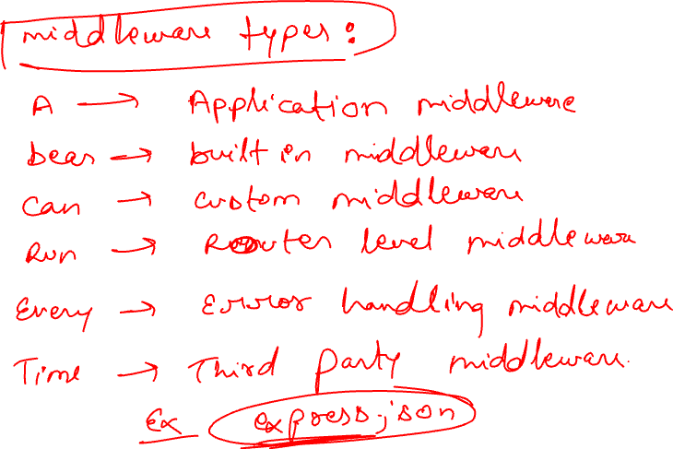

Slide 6


